Slide 1
Exploratory Data Analysis
Report:- Customer Churn Analysis

Slide 2
Business Understanding & Overview
You have to use EDA to Analysis the customer who are churn.
We will perform this Exploratory Data Analysis in order to get actionable insights, and covert them into meaningful stories and present it so that the companies can take necessary actions in order to retain their customers.

Slide 3
Understanding the data

Slide 4
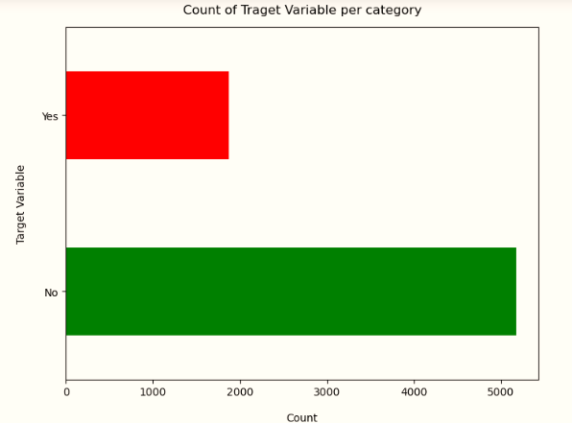
Target Variable Findings:-
Data is highly imbalance ratio is almost 73.27.
So we analyze the data with other features while taking the target values separately to get some insights.
Most of churns we finds in month to month contracts.

Slide 5
Missing Data Findings:-
In Dataset there is no missing values but as we check the Total column data type is object then we convert the data type from object to integer.
In Total Charges columns in Data having 11 Missing data which is almost 0.5% of the Data so we Drop them
As there’s no thumb rule on what criteria do we delete the columns low number of missing values , to get the clean data because they do not effect the insight from the data Frame.

Slide 6
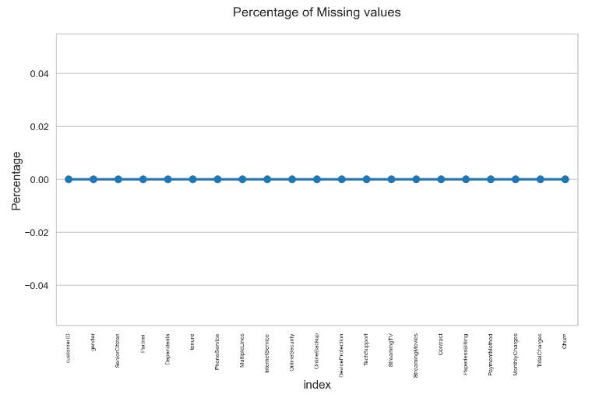
Initial Intuition from the data Findings:-
There are only one column (‘Total Charges”) has null values:11 after converting column Total Charges data type from object to integer.
As there ‘s no such thumb rule to drop the variable having more than that they effect the Dataset and also there is no column is depends on that particular column so we drop the all those null value.
In later stage we can also analyze the other 11 columns that we are deleting if they carry any important information or not.

Slide 7
Categorical Analysis

Slide 8
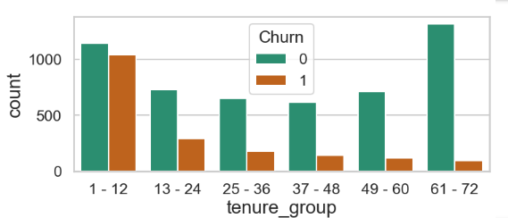
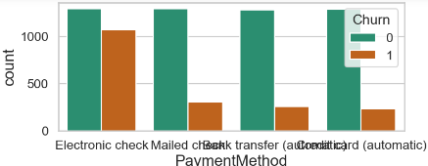
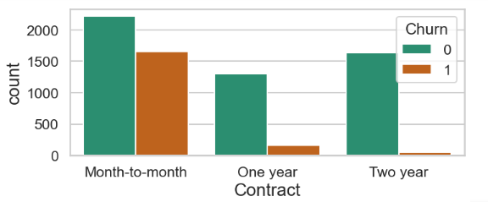
Univariate Analysis
Findings :-
By Just analyzing single variable we won’t find much insight related to Customers Churn, as here we will Just have an idea which category of customer are present in Churn, other than that in mentioned chart we can see the insight that tenure in between 1-12 ,Electronic check payment method and Month to Month contracts customers are more likely to churn in comparison to other.

Slide 9
Contracts Findings:-
As per the Contracts variable customers who having Month to Month contacts they are most likely to churn in comparison of other.
As per Contract variable customer churn percentage is almost 41% in Month to month contracts and 12 % in One year contacts.

Slide 10
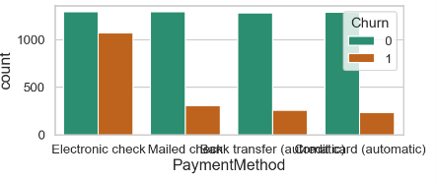
Payment Method Findings:-
As per the Payment Method columns customers who having Electronic Check they are most likely to churn in comparison of other.
As per the payment method variable almost 44% in Electronic check , 17% in Mailed Check ,15 % in Bank transfer and around 12%-13% of customer who are using these Payment Method are likely to churn.

Slide 11
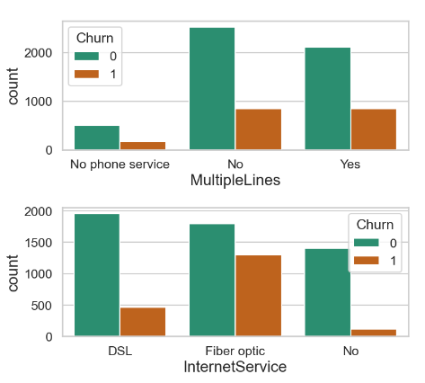
Multiple Line & Internet Service Findings:-
As per the Multiple Phone Services Variable almost 30% to 40% both who having phone service, not phone services and also who have no services they are likely to churn.
As per the Internet Services variable almost 70% of customers who having Fiber optic service and 25% DSL services they are likely to churn.

Slide 12
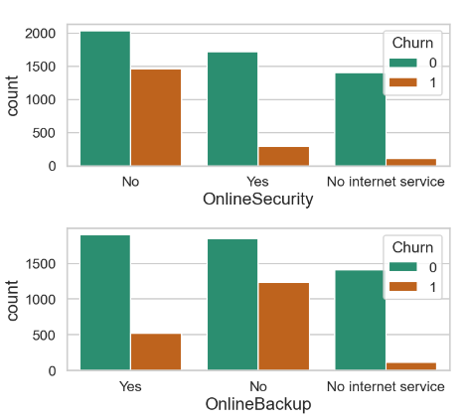
Online Security & Online Backup Findings:-
As per the Online Security Variable customers who having no online security(around 42%) they are most likely to churn in comparison to others.
As per the Online Backup Variable customers who having no online Backup(around 37%) they are most likely to churn in comparison of other.

Slide 13
Numerical Analysis

Slide 14
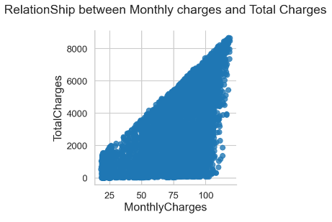
Correlation between Monthly Charges & Total Charges Findings:-
This Graph show the correlation between Monthly charges and Total charges.
This graph shows that when the Total charges increase then Monthly charges are also increases Vise – Versa.
It show the Positive correlation between Monthly charges and Total charges.

Slide 15
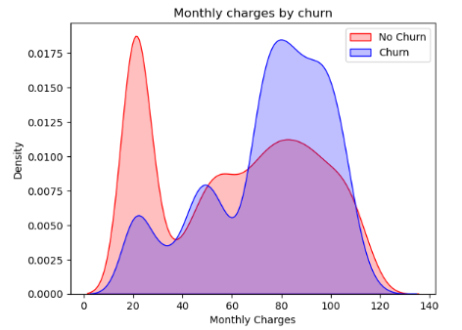
Monthly Charges by Churn & No Churn Findings:-
This Plot show the Churn rate and No churn rate as per the Monthly charges.
As per the plot we get the insight the when the Monthly charges are high then customer churn rate is also high and Vise-versa.
In pervious chat of the contract we also get the same insight for the Month to Month contract the churning percentage his much higher in comparison of one year and two year contracts.

Slide 16
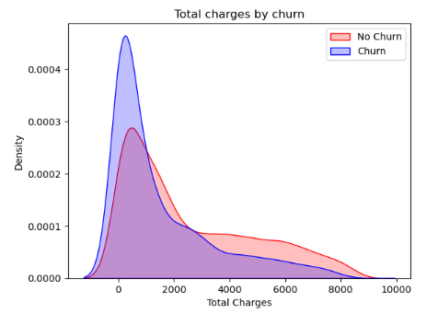
Total Charges by Churn & No Churn Findings:-
This Plot show the Churn rate and No churn rate as per the Total charges.
As per the plot we get the insight the when the Total charges are high then customer churn rate is also low and Vise-versa.
It show the Negative correlation between the Total charges and Customer Churn Rate.

Slide 17
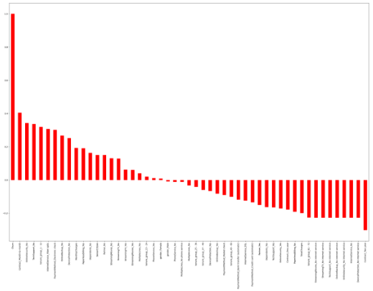
Correlation Of all Variables with Churn Findings:-
This Plot show the Churn who are the above of the 0 in Y- axis and they who are down 0 in Y axis are the No churner.
High churn seen in the case of Month to month contracts, No online Securities, No Tech support , First Year of Subscription and Fiber Optics internet services...
Low Churn seen in case of Long Term contacts, Subscription without internet services and the customers engaged for 5+ Years.
Factors like Gender, Availability of Phone Services and of multiple lines have almost NO impact on churn.
In next Page of slide we have use Heat-map plot to understand churn as per variable and rows.

Slide 18
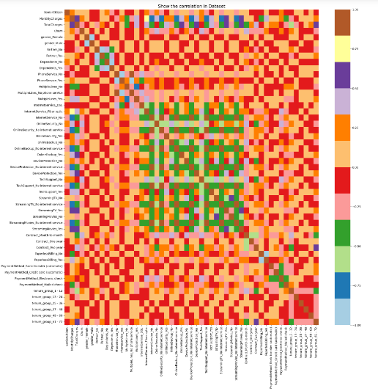

Slide 19
Bivariate Analysis

Slide 20
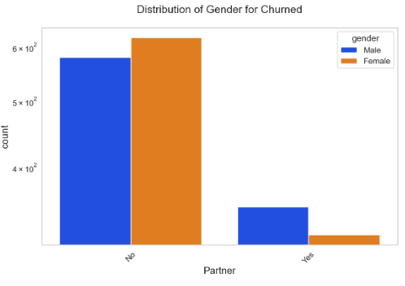
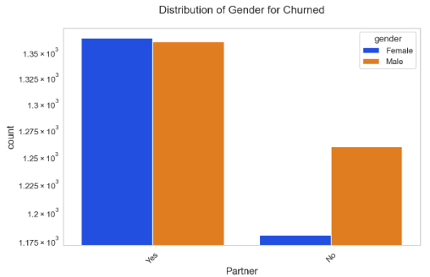
Churn Analysis as per Partner & Gender Finding:-
As per the First Bar plot we see that People who don't have a partner are the churner in which Females are more likely to churn in compare to males.
As per the second Bar chart we can see that People who have a partner are the churner in which Males are more likely to Churn in compare to Females.

Slide 21
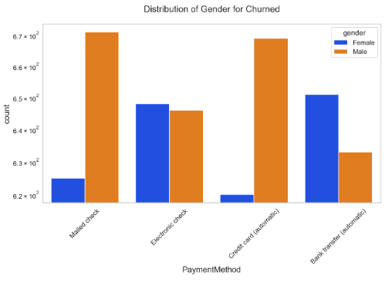
Churn Analysis as per Payment Method & Gender Findings:-
In this Bar Chart we can see the customer churn on basis of payment method and gender.
As per the Payment Method Females are more likely to churn in compare to the male as we can see in Bar chart in Male check & Credit card Bars.
And In reset of the bars male are more likely to churn.

Slide 22
Final Thoughts:-
Electronic check are the highest churners.
Contract Type- Monthly customers are more likely to churn because of no. contract terms, as they are free to go customers.
No online Security, No Tech Support category are high churners.
Non Senior citizens are high Churners.
Organization has to focus on Month to month contracts and try for customer Acquisition or retain old customer by providing better offer than the competitor.
Organization have to provide the Online Security ,Online backup and Tech support to customer who don’t have these because mostly they are churn it is the best way to acquire them.
Tenure Group from 1-12 are more likely to churn so we have to find the reason for the churn like the Int. Speed, Network etc.
Organization have to improve the quality of the fiber optic and DSL Internet services.

Slide 23


